Slide 1
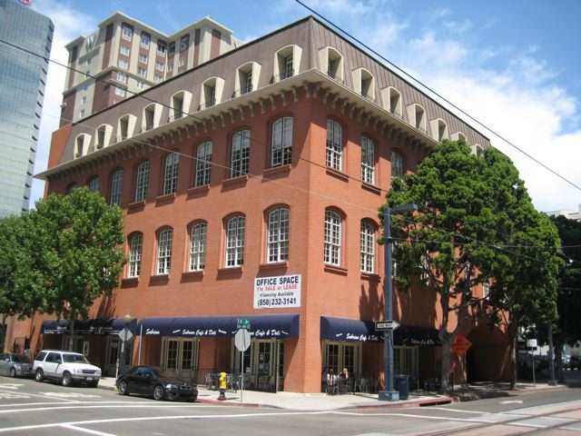
DOWNTOWN
San Diego
RETAIL SUITE FOR SALE/LEASE
DOWNTOWN
Columbia Court Retail Suite
444 W. “C” St. | San Diego | 92101
(corner of Columbia & C Streets)
1,570 SF with 250 SF patio
Available October 1st 2012
Hard Corner location on the Trolley line on C St.
Immediately adjacent to downtown Courthouse
Architecturally unique 4-story courtyard building
Charming brick construction with wrought iron details
Located on the same block as the renowned W Hotel
in the heart of the “west side” of downtown San Diego.
Up to 14 foot ceilings & operable windows
Direct access to Trolley Line & Santa Fe Train Depot
Newly renovated common areas
2,000,000 SF of Office Space with 3 block radius
Bathroom located on first floor, not within suite
For more information contact:
Mike Demko
858-232-3141
mike@demkoinvestments.com
Available
Oct 1st 2012
Why LEASE when you can OWN your own retail/restaurant space?
This information is compiled from data that we believe to be correct but no liability is assumed by this
Company as to accuracy of such data.

Slide 2
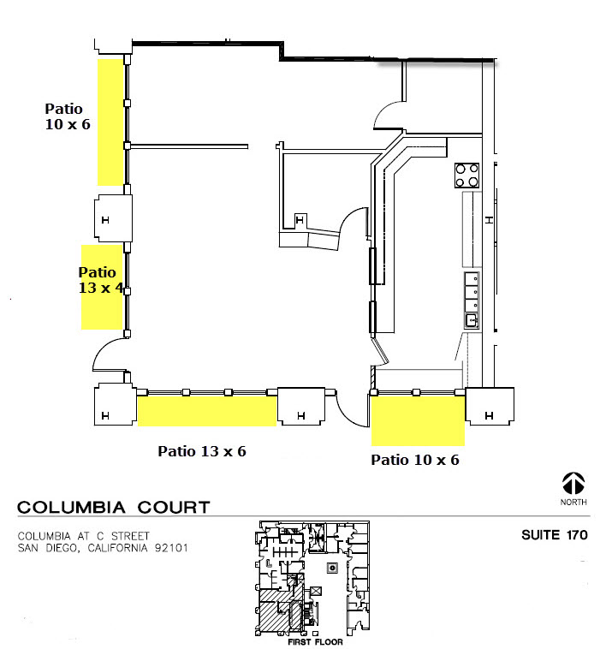
For Sale/For Lease
Floor Plan
Suite 170
Available: October 1st 2012
For more information, contact:
Columbia St.
Mike Demko
858-232-3141
mike@demkoinvestments.com
*Common Areas shaded gray
C Street
This information is compiled from data that we believe to be correct but no liability is assumed by this
Company as to accuracy of such data.

Slide 3
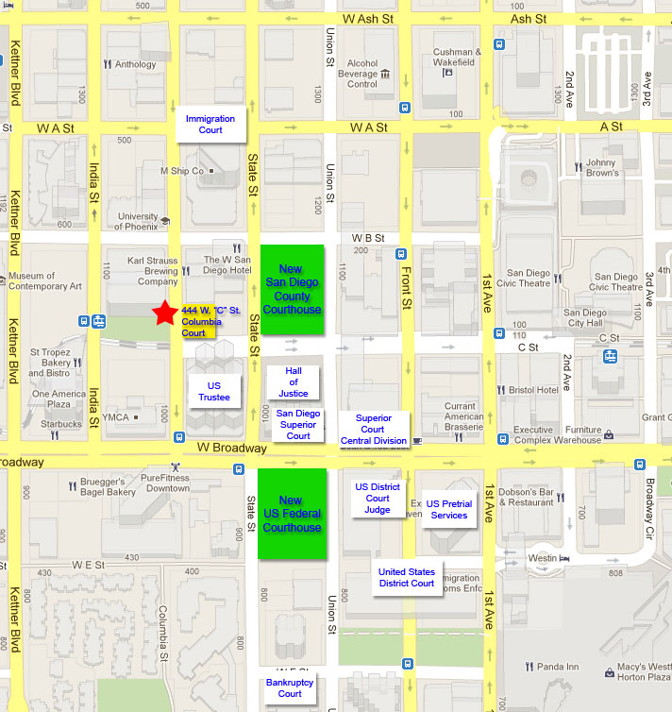
For Sale/For Lease
Immediate Trade Area – Retail Demand Drivers
Over 2,000,000 SF of Class A Office within 3 blocks = 12,000 jobs
2 Hotels – The W and Westin
Immediately adjacent to the New County Courthouse
1 Block from Broadway and the Santa Fe Train Depot
Great Visibility from the Trolley Line
Residential Tower
Residential Tower
Office Tower
Residential Tower
Office Tower
Columbia St.
Hotel
Office Tower
Office Tower
Office Tower
Hotel
Mike Demko
858-232-3141
mike@demkoinvestments.com
Office Tower
Residential Tower
*Common Areas shaded gray
C Street
This information is compiled from data that we believe to be correct but no liability is assumed by this
Company as to accuracy of such data.

Slide 4
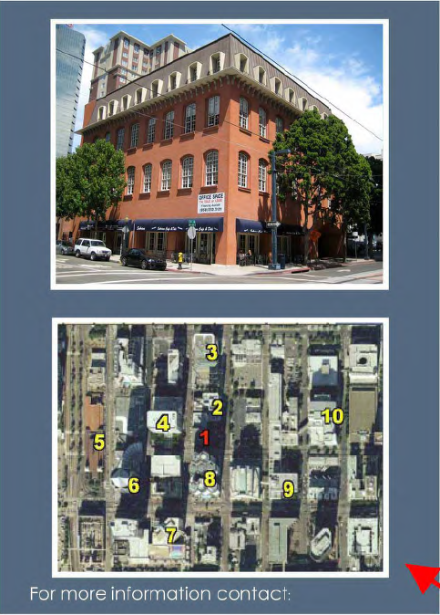
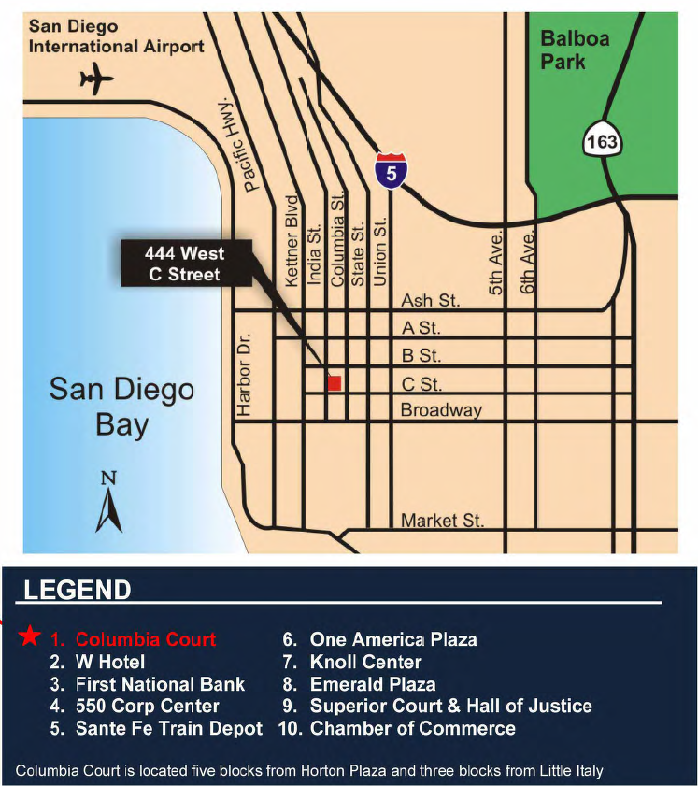
LOCATOR MAP
COLUMBIA COURT
Mike Demko
858-232-3141
mike@demkoinvestments.com
This information is compiled from data that we believe to be correct but no liability is assumed by this
Company as to accuracy of such data.

Slide 5
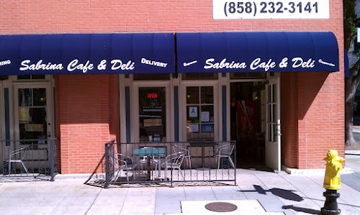
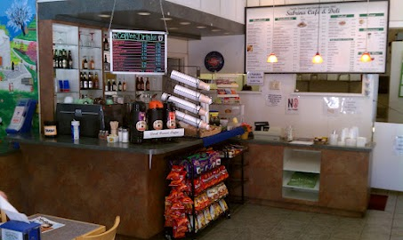
For Sale/For Lease
Photos
Columbia St view
Existing Improvements
Columbia St.
Mike Demko
858-232-3141
mike@demkoinvestments.com
*Common Areas shaded gray
C Street
This information is compiled from data that we believe to be correct but no liability is assumed by this
Company as to accuracy of such data.

Slide 6
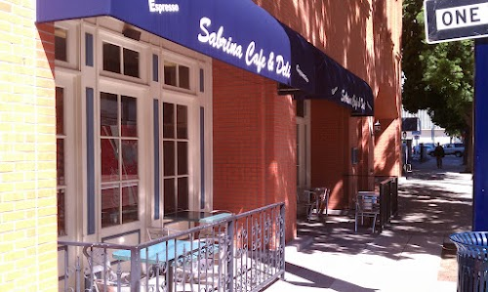
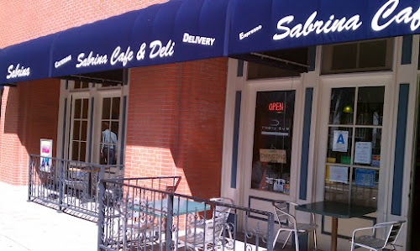
For Sale/For Lease
Photos
View from C St corner heading East
View from Columbia St. heading North
Columbia St.
Mike Demko
858-232-3141
mike@demkoinvestments.com
*Common Areas shaded gray
C Street
This information is compiled from data that we believe to be correct but no liability is assumed by this
Company as to accuracy of such data.

